Slide 1
PRIVACY PRESERVING K-MEANS CLUSTERING ALGORITM
Sudharchith Sonty
50169912
Sudharch@buffalo.edu

Slide 2
INTRODUCTION
primary task in data mining is the development of models about aggregated data, extracting implicit un-obvious patterns and relationships from a warehouse of data sets.
This information can be useful to increase the efficiency of the organization and aids in future planning.
However, of late, internet phishing caused significant security and economic concerns on the users and enterprises worldwide.
Diversified communication channels via internet services such as electronic commerce, online-banking, research, and online trade exploiting both human and software vulnerabilities suffered from tremendous financial loss.

Slide 3
introduction
confidential information in terms of data analysis, validation, and publishing. Ever-escalating internet phishing posed severe threat on widespread propagation of sensitive information over the web.
Therefore, enhanced privacy preserving data mining methods are ever-demanding for secured and reliable information exchange over the internet.
The dramatic increase of storing customers’ personal data led to an enhanced complexity of data mining algorithm with significant impact on the information sharing.
Amongst several existing algorithms, the Privacy Preserving Data Mining (PPDM) renders excellent results related to inner perception of privacy preservation and data mining.

Slide 4
TARGET FUNCTIONALITY
Secure multiparty computation protocol that can carry out the required computation without requiring a trusted third party.
I/O efficient protocol.
Scalable, across horizontally partitioned databases

Slide 5
PROPOSED SOLUTION
Privacy-preserving distributed data mining allows the cooperative computation of data mining algorithms without requiring the participating organizations to reveal their individual data items to each other.
Clustering is a well-studied combinatorial problem. The task is to group similar items in a given data set into clusters with the goal of minimizing an objective function.
The error-sum-of-squares (ESS) objective function is defined as the sum of the squares of the distances between points in the database to their nearest cluster centers.

Slide 6
PROPOSED SOLUTION
One solution is presented as a simple deterministic algorithm, Recluster, for I/O-efficient k-clustering.
The algorithm was designed with conversion to a privacy-preserving version in mind, examines each data item only once and uses only sequential access to the data.
Although there have been previously established, privacy preserving versions of the K-Means algorithms, these algorithms do not scale well to large databases, involve complicated data structures, or can be complicated to transform into a privacy-preserving protocol.
This protocol is communication efficient and it reveals the cluster centers (or the cluster assignments to data, if both parties desire) to both parties only at the end of the protocol and does not reveal intermediate candidate cluster centers.

Slide 7
ASSUMPTIONS
We assume that Alice and Bob are semi-honest, meaning that they follow their protocol as specified, but may try to use the information they have learned (such as messages they receive) to infer information about the other party’s data.
We say that Alice and Bob have random shares of a value x drawn from a field F of size N (or simply Alice and Bob have random shares of x) to mean that Alice knows a value a ∈ F and Bob knows a value b ∈ F such that (a + b) mod N = x, where a and b are uniformly random in field F.
We assume that a finite field F of a sufficiently large size N is chosen such that all computations can be done in that field, and all computations throughout the remainder of the paper take place in F.
We assume that a Semantically Secure encryption protocol is used.

Slide 8
Paillier cryptosystem
We choose two random prime numbers p and q such that gcd(pq, (p-1)(q-1) ) is 1
compute two values n =pq and ƛ = (p-1)(q-1)
We assume that p and q are of equal length.
Now we select an Integer g = n +1, μ = [(p-1)(q-1)]⁻¹
The public encryption key is (n,g)
The private decryption key is (ƛ, M)

Slide 9
Algorithm FLOW
INPUT
We read the data from a text file and convert it into a TreeMap.
MERGE THE CENTROIDS
We merge the clusters in the final step , if the termination condition is met.
OUTPUT FINAL RESULT
GET INITIAL CENTROIDS
COMPUTE CLUSTERS
K random centroids are chosen for the initial run of the algorithm.
Using a secure protocol, the clusters are recomputed
Finally, we output the result.

Slide 10
DATA INPUT
The input will be a file containing nodes with certain assigned ground truth values and at the end of the computation we can compare these ground truth values to the values obtained by the clustering algorithm.
The input is divided into two equal halves and each half computes its clusters on its own.
Initially, the input is stored in a TreeMap and during execution, both the halves are stored in two different treemaps.

Slide 11
COMPUTING INITIAL CLUSTERS
THE INITIAL CENTROIDS ARE COMPUTED BY TAKING 5 RANDOM VALUES FROM THE INPUT DATA SET.
AFTER TAKING THE INPUT DATA IN THE FORM OF A HASHMAP, WE STORE THE INITIAL CENTROIDS GENERATED USING THE RANDOM GENERATOR FUNCTION IN JAVA IN A SEPARATE HASHMAP, WHERE THE KEY IS THE NODE ID AND THE VALUES ARE THE ASSOCIATED ATTRIBUTES.
EACH RUN WILL GENERATE RANDOM INITIAL CENTROIDS.

Slide 12
SECRET SHARING
A (t, n) secret sharing scheme is a set of two functions S and R. The function S is a sharing function and takes a secret s as input and creates n secret shares: S(s) = (s₁, . . ., s_{n}). The two functions satisfy that for any set I ⊆ {1, . . ., n} of t indices R (I, s_{I1}, . . ., s_{It}) = s.
Furthermore, we require that it is impossible to recover s from a set of t − 1 secret shares.
A very simple (n, n) secret sharing scheme which is additively homomorphic is S(s) = (r1, . . ., r_{n−1}, r), where r_{i} is random for i ∈ {1, . . ., n − 1}, and r = s − P_{n−1i=1} ri. To recover s all secret shares are added: s = r + P_{n−1i=1} r_{i}.

Slide 13
SECURE CLOSEST CLUSTER COMPUTATION
Aliice computes k cluster centers and Bob computes k cluster centers. Alice and Bob randomly share these cluster centers with each other.
Bob chooses a random permutation and random values. using secret share they obtain random shares of Alice’s k-cluster centers.
Alice chooses a random permutation and random values using secret share they obtain random shares of Bob’s k-cluster centers.

Slide 14
SECURE CLOSEST CLUSTER COMPUTATION
Bob chooses a random permutation and random values and using secret share they obtain random shares of Alice’s k-cluster centers. Bob adds the shares just obtained to his data.
Alice chooses a random permutation and random Using secret share they obtain random shares of Bob’s k-cluster centers. Alice adds the shares just obtained to her data.
Alice and Bob repeat the protocol to securely merge clusters k times to merge 2k clusters into k clusters

Slide 15

MERGE CLUSTERS
The merge clusters function essentially , merges the clusters obtained from the two halves of the data into one set of clusters.
We do this by repeatedly choosing a best pair of clusters Ci and Cj for merging, and replacing them in the clustering with C_{i} ∪ C_{j}
A best pair of clusters is one with least error. We use a variation of the notion of error defined in Ward’s algorithm. Let C₁ and C₂ be two clusters being considered for a merge.
Let C. weight denote the number of objects in cluster C. In Ward’s Algorithm, the error of C₁ ∪ C₂ is error_{w}(C₁∪C₂) = $\frac{C1. weight ∗ C2. weight ∗ dist2 (C1, C2) }{C1. weight + C2. weight}$, where dist. (C₁, C₂) is the distance between the centers of C₁ and C₂.
We define the error as error_{r} (C₁ ∪ C₂) = C₁. weight ∗ C₂. weight ∗ dist² (C₁, C₂).

Slide 16
PERFORMANCE ANALYSIS
The overall computational complexity of the privacy-preserving version of the protocol is O(k³ℓ) encryptions, and O(nk³ℓ) multiplications for Alice and O(k³ℓ) exponentiations, O(k²) encryptions and O(nk³ℓ) multiplications for Bob.
k denotes the number of clusters,
n denotes the size of the data
ℓ denotes the number of attributes in the data
c denotes the maximum number of bits for an encryption.
The communication complexity is O(k³cℓ) bits, which does not depend on n.

Slide 17
SECURITY GUARANTEE
Both parties compute k clusters independently from the data objects they own. They communicate with each other when they merge 2k clusters into k clusters.
They use the permute share protocol twice to prevent each party from keeping track of the cluster centers across iterations
These protocols are secure. They do not leak any information. The cluster centers at the end of the merge clusters protocol is obtained as a random shares between the two parties.

Slide 18
SECURITY GUARANTEE
When the parties like to compute the cluster centers they exchange their shares to each other. All the intermediate results are also available as random shares between the two parties.
The protocol achieves the same privacy as when a trusted third party is used.
Both parties cannot learn any information from the encrypted messages that are communicated since the encryption scheme chosen is semantically secure.

Slide 19
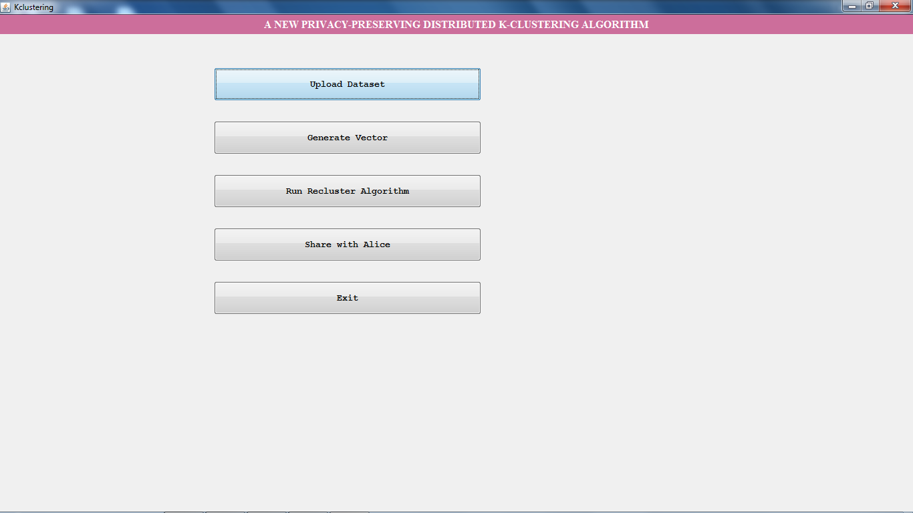

Slide 20
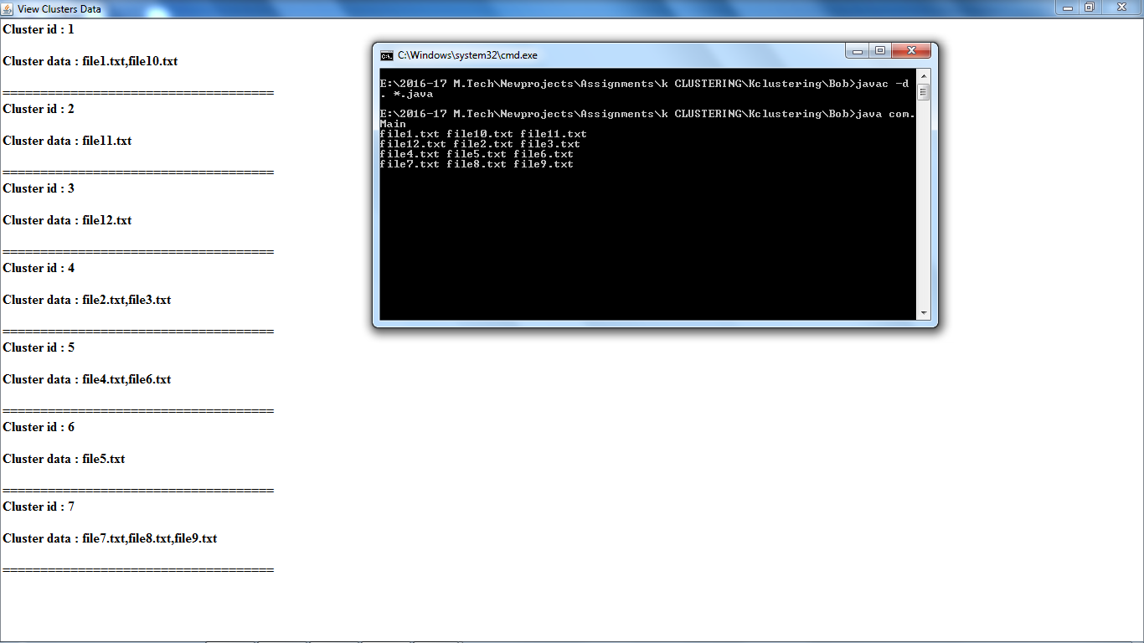

Slide 21
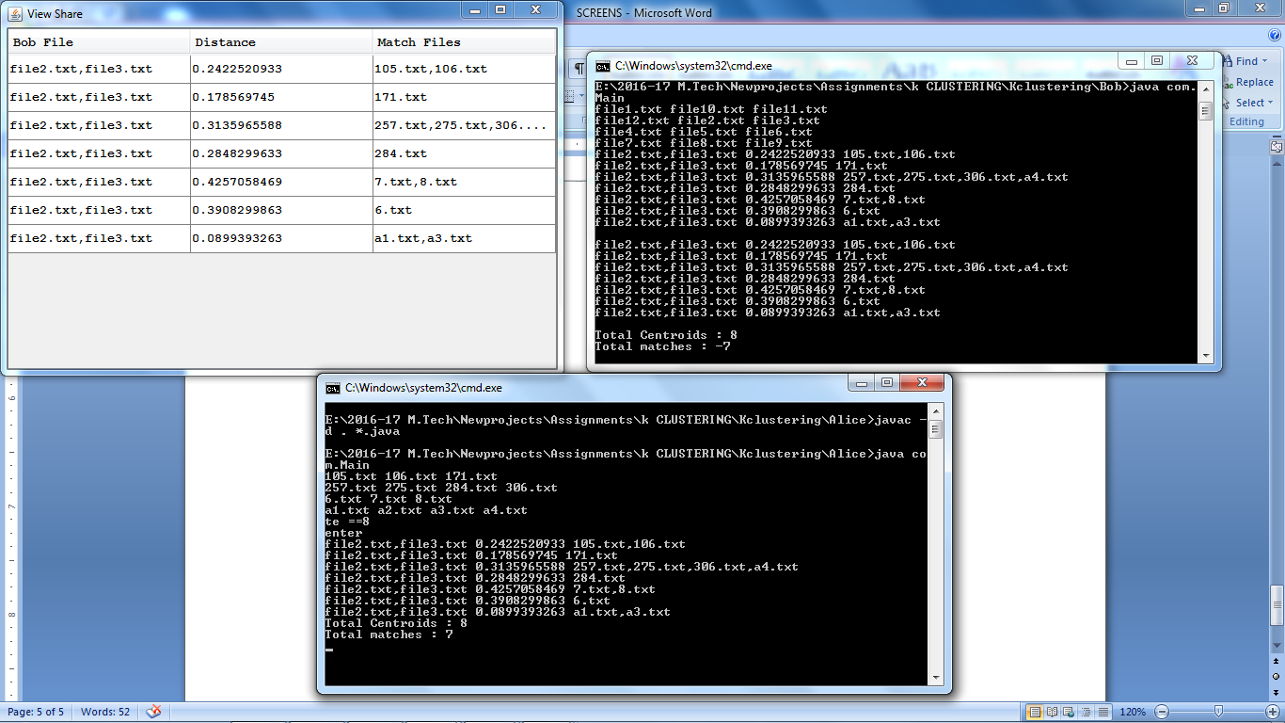

Slide 22
REFERENCES
http://www.siam.org/meetings/sdm06/proceedings/048jagannag.pdf
http://www.cs.ucsb.edu/~veronika/MAE/summary_clusteringdatastreams_theorypractice_guha.pdf
https://pdfs.semanticscholar.org/0ab4/26e3244128fb1cf717db2d65cbb9d41dad0e.pdf
http://www.carch.ac.cn/~huimin/papers/CF.pdf

Slide 23
THNK YOU

Slide 24
QUESTIONS??

